Slide 1

Muggu Jaya Sree
IIT Indore
Metallurgy and Materials Science Engineering

Slide 2

Scientific Uniqueness & Literature Benchmarking
Benchmarking Against Reported Self-Cleaning Systems
System | Mechanism | Key Limitation | CASRE Differentiation
Superhydrophobic nano-rough coatings (silica/lotus type) | Micro/nano roughness, high contact angle | Fragile; dust entrapment; poor recoating | Smooth film; no nano-texture; chemistry-driven switching
Fluoropolymer coatings | Permanent low surface energy (–CF enrichment) | PFAS concerns; high cost; repaint issues | Fluorine-free; acrylic - compatible; regulatory aligned
TiO₂ photocatalytic coatings | UV-activated degradation, hydrophilicity | UV dependent; weak indoor performance | Non-photocatalytic; works interior & exterior
Silicone-modified paints | Static siloxane surface enrichment | Limited oil/household stain release | Dynamic dry–wet surface reconstruction
Advantages
Fluorine-free and regulatory-aligned
Smooth & recoatable
Interior + exterior functionality
Compatible with existing acrylic infrastructure
Core Scientific Innovation
Reversible Amphiphilic Surface Reconstruction
Dry state: PDMS enrichment → reduced dust adhesion
Wet state: Hydrophilic segment exposure → enhanced stain release
Post-cleaning: Surface re-equilibrates to low-adhesion configuration
Mechanism is chemistry-driven and reversible
Defined End Use
Premium architectural coatings for high-traffic interiors and exposed urban facades requiring reduced maintenance cycles.
Literature Basis: Reported superhydrophobic silica systems, fluoropolymer coatings, TiO₂ photocatalytic coatings, and silicone-modified architectural paints.

Slide 3
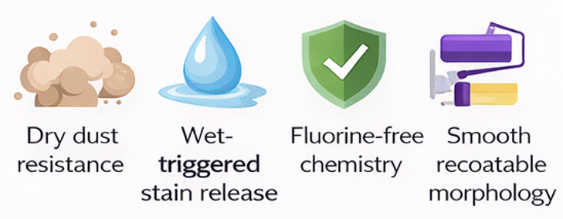
Commercial Availability & Practical Differentiation
Current commercial categories
Maintains tintability, gloss options & ASTM-compliant durability.
Current commercial categories
CASRE Differentiation
✓ Broad-spectrum stain resistance ✓ Fluorine-free & regulatory aligned ✓ Recoatable smooth film ✓ Manufacturing compatible
Existing Market Categories
• Standard acrylic emulsions • Silicone-modified exterior • Premium washable interior • Fluoropolymer Specialty
Identified Gap No single system integrates: ✓ Dry dust resistance ✓ Wet-triggered stain release ✓ Fluorine-free chemistry ✓ Smooth recoatable morphology
Key Technical Risks
• Surface reconstruction rate may vary
with temperature
• Requires graft-density optimization
• ~5–8% raw material premium
“CASRE integrates all four functionalities in a single adaptive coating platform.”
Maintains tintability, gloss options & ASTM-compliant durability.

Slide 4
Stain Resistance Scope – Interior & Exterior
Interior Stains – Easy-Clean Mode
Exterior Stains – Self-Clean Mode
Target Household Stains
Tea, Coffee
Turmeric, Mustard
Oil / grease
Ketchup / pickle
Crayon / Pencil / marker / pen
Target Environmental Contaminants
Dust accumulation
Mud splash
Bird droppings
Carbon soot / pollution
Rust marks
Betel leaf stains
Expected Performance
Reduced dry dust adhesion
Rain-triggered stain release
No permanent staining after rain or
low-pressure water wash
Lower dirt pick-up index compared to
standard acrylic benchmark
Expected Performance
Reduced surface adhesion (dry state)
Limited stain penetration into film matrix
≥85–90% visible stain removal after damp wipe
No permanent staining after controlled
cleaning cycles
Cleaning Method
Damp cloth
Mild detergent (if required)

Slide 5
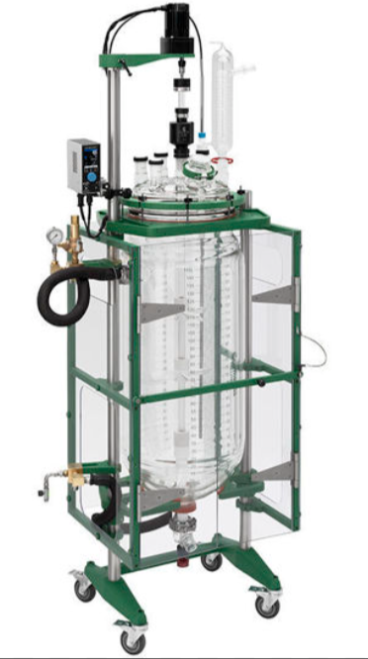
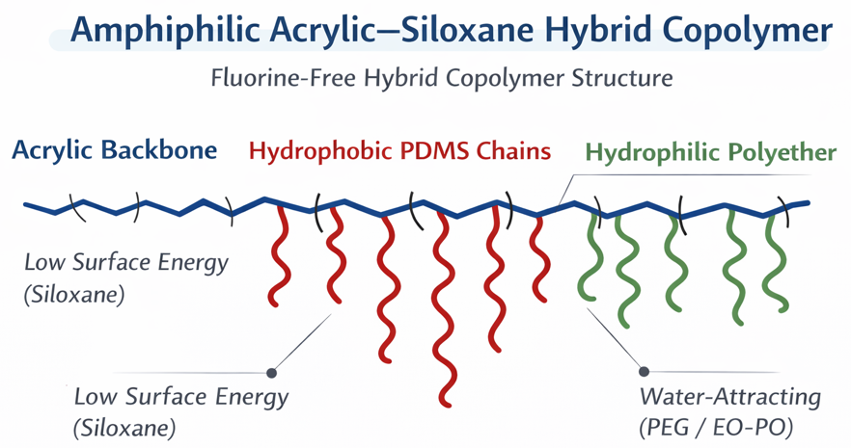
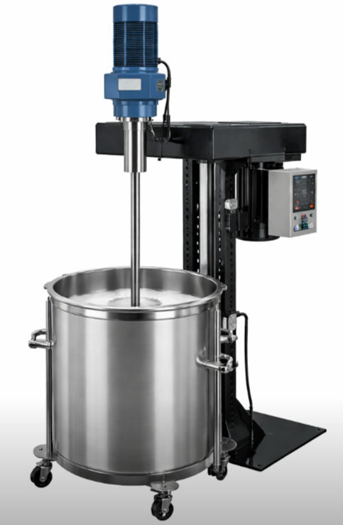
Processing Route & Formulation Strategy
Pre-Emulsion Preparation & Seeded Polymerization (70–80°C)
Siloxane Functional Monomer Grafting
PDMS-functional incorporation into acrylic backbone
Polymer Synthesis Stage
Pre-emulsion of BA/MMA monomers
APEO-free surfactant system
Seeded emulsion polymerization (70–80°C)
Particle size control
Final Processing, Quality Control & Packaging
Functional Additive Incorporation
Pigment & Filler Dispersion
Amphiphilic acrylic–siloxane adaptive copolymer
Silicone slip modifier (surface release)
Barrier additive (stain penetration resistance)
PVC range: 35–45%
Rheology modifier addition
Defoamer addition
UV stabilizer incorporation
Filtration & packaging
Rutile TiO₂ (opacity & brightness)
Surface-treated CaCO₃
Fine treated silica
High-speed disperser for uniform
dispersion

Slide 6
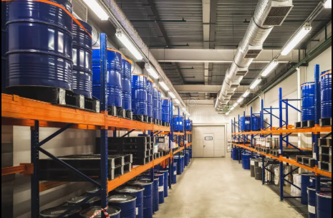
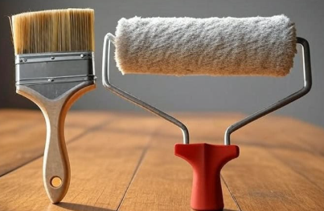
Raw material safety, Storage & Application
Raw Material Safety & Regulatory Alignment
Safe Handling & Compliance
Storage & Stability
Application Technique
Binder System • Water-based acrylic–siloxane hybrid • Low VOC formulation • Fluorine-free (no PFAS)
Additives • Silicone slip modifier – low toxicity grade • Barrier additive – non-reactive polymeric additive • APEO-free surfactant system
Regulatory Alignment • Aligned with architectural water-based coating standards • No heavy metal pigments • Compatible with green building certifications
Handling • Non-flammable system • Standard PPE (gloves, goggles) sufficient
Storage Conditions
• Store at 5–40°C • Protect from freezing • Avoid prolonged direct sunlight • Shelf life target: 12–18 months • Maintain sealed containers to prevent
skin formation
• No special hazardous transport
requirements
Compatible with existing paint warehouse infrastructure.
Surface Preparation • Clean, dry, dust-free substrate • Compatible with standard acrylic primer
Application Methods • Roller / Brush / Airless spray • Recommended DFT: 80–120 µm (2 coats)
Curing • Ambient cure • Touch dry: 30–60 min • Recoat: 4–6 hrs
Cleaning • Water-based clean-up

Slide 7
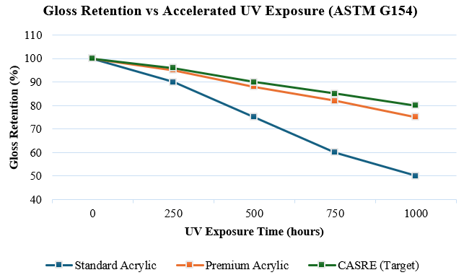
Development Challenges & Mitigation
Expected Durability
Challenge | Technical Risk | Mitigation Strategy
Surface Reconstruction Stability | Loss of switching efficiency over long-term exposure | Optimized graft density; controlled PDMS molecular weight; crosslinked acrylic stabilization
UV Degradation of Polymer Matrix | Chalking / performance decay in exterior exposure | HALS + UV absorber package; siloxane backbone improves UV resistance
Abrasion & Scrub Resistance | Surface smoothing may reduce mechanical durability | Balanced PVC (35–45%); optimized binder-to-pigment ratio; ASTM scrub validation
Climate Variability (Humidity / Temperature) | Switching kinetics may vary across climates | Accelerated climate cycling tests; formulation tuning for humidity response
Interior (ASTM D2486)
•Scrub resistance: >2000 scrub cycles • No ghost staining • Repaint cycle: 5–7 years
Exterior (ASTM G154 / Accelerated UV) • Anti-chalking • Reduced dirt pick-up • 5–7 years service life
“Designed to match or exceed premium acrylic durability standards while delivering adaptive self-cleaning functionality.”

Slide 8
Prototype Development & Validation Plan
Facilities Required
Polymer & Formulation Development
Jacketed glass reactor (70–80°C emulsion polymerization)
High-speed disperser
Lab-scale mixing tanks
Particle size analyzer
Performance Characterization
Contact angle goniometer (dry/wet switching validation)
ASTM D2486 scrub tester
Gloss meter
QUV accelerated weathering chamber
Dirt pick-up resistance panel setup
Application & Field Testing
Drawdown applicator
Spray / roller setup
Outdoor exposure racks (urban environment)
Development Timeline (12–18 Months)
Phase 1
(0–3 months)
Phase 2
(3–6 months)
Phase 3
(6–12 months)
Phase 4
(12–18 months)
Phase 1 (0–3 months)
Polymer synthesis optimization
Graft density tuning
Phase 2 (3–6 months)
Coating formulation
Stain resistance validation
Initial scrub testing
Phase 3 (6–12 months)
Accelerated UV & climate cycling
Switching durability evaluation
Phase 4 (12–18 months)
Pilot batch scale-up
Field exposure
Cost benchmarking
Proof of Concept – Validation Methodology
Validation Area | Test Method
Scrub Resistance | ASTM D2486 scrub test
UV Stability | QUV accelerated weathering (1000 hr cycle)
Stain Resistance | Standardized stain panel + wipe protocol
Dirt Pick-Up | Outdoor exposure & reflectance change (ΔL*)
“All facilities aligned with existing architectural paint R&D infrastructure.”

Slide 9
Scalability Strategy (Lab → Bulk)
Scale-Up Pathway
Lab Scale (1–5 L)
Polymer synthesis validation
Switching mechanism optimization
Initial coating formulation
Pilot Scale (50–100 L)
Batch reproducibility testing
Graft density consistency
Pigment dispersion uniformity
Stability evaluation (shelf life)
Commercial Scale (1000+ L)
Standard architectural paint plant
integration
Let-down stage additive incorporation
No new reactor design required
Scale-Up Risks & Controls
Infrastructure Compatibility
Water-based emulsion system
No fluorochemicals
No nano-texturing or exotic curing
Compatible with standard high-speed dispersers
Uses existing pigment/filler supply chain
Scale Risk | Control Strategy
Particle size variation | Controlled monomer feed rate
Graft uniformity issues | In-process QC monitoring
Batch viscosity variation | Standard rheology adjustment
Storage instability | Accelerated stability testing
“Fully compatible with conventional architectural paint manufacturing infrastructure.”

Slide 10

Business Case & Market Feasibility
Target Market & Customer
Primary Segment (Entry Strategy)
Premium interior easy-clean paints
Urban exterior coatings (pollution-heavy cities)
Hospitals, schools, airports, metro stations,
Smart city infrastructure
Why Premium First?
Customers already pay for washability
Value perception is higher
Easier margin absorption
“Positioned within premium architectural coatings with adaptive easy-clean advantage.”
Cost & Feasibility Cost Impact
~25% Lower Lifecycle Cost
Slight binder cost increase (~5–10%)
No additional plant CAPEX required
Uses existing manufacturing infrastructure
Standard pigment & filler supply chain
Pricing Strategy
10–15% above premium acrylic segment
Positioned as performance-enhanced coating
Value Proposition & Competitive Edge For Customers
Reduced cleaning frequency
Lower long-term maintenance cost
Extended repaint cycle (5–7 years)
Fluorine-free sustainability advantage
For Manufacturer
Incremental margin expansion
No major R&D infrastructure shift
Premium product differentiation

